Slide 1
Using deep learning and time-series forecasting to reduce transit delays

Slide 2
Introduction
Use a publically available dataset on streetcar delays to create a model to predict and prevent delays
Apply time series forecasting to understand the seasonal nature of delays and deep learning to predict delays
Example of:
Applying deep learning to a raw dataset in structured tabular format
Transforming ill-formed address information into map visualizations
Combining multiple data types (continuous, categorical and text) in a single deep learning model

Slide 3
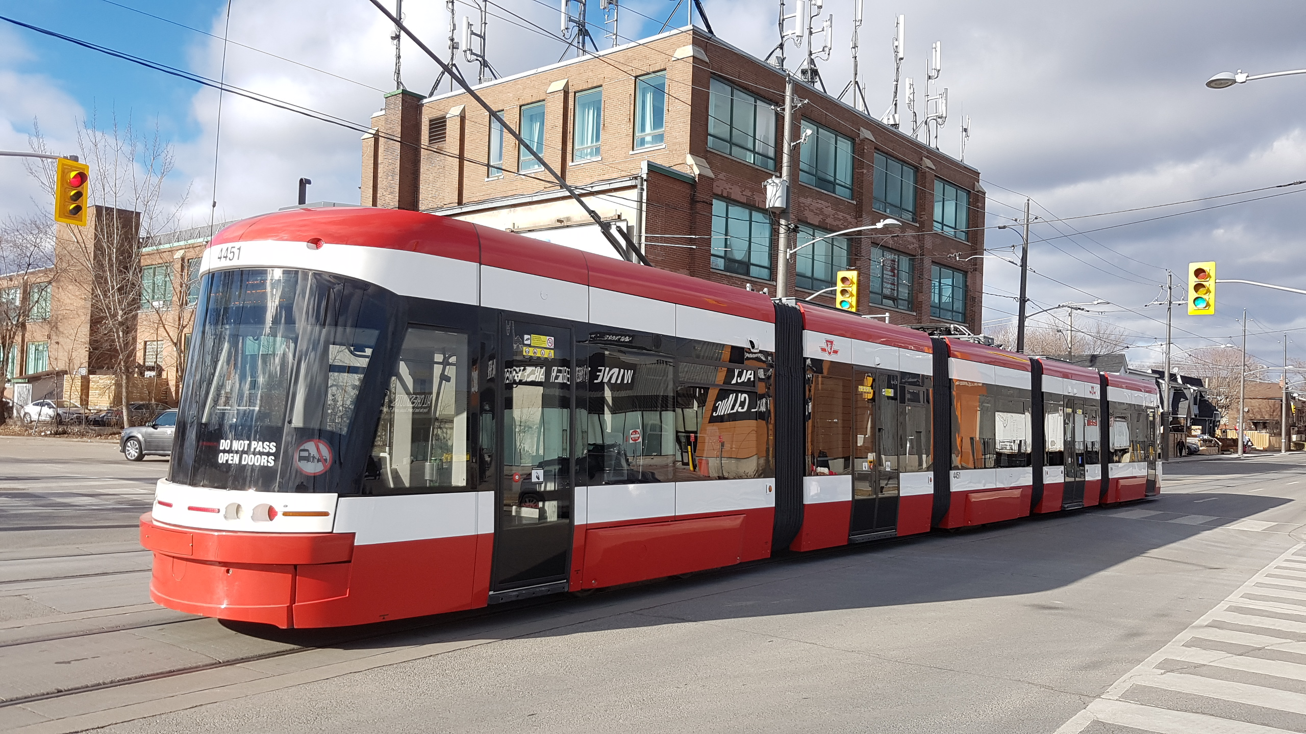
The problem: streetcar delays
Toronto has the biggest network streetcar network in North America
Advantages: greener / lower labour cost than buses; cheaper than subways
Major disadvantage: delays trigger gridlock
Prevent gridlock by predicting and preventing delays

Slide 4
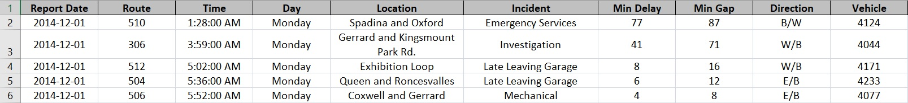
The dataset
~70 k records with details of all streetcar delays since January 2014
No error checking on data entry = messy data:
Invalid routes, vehicles, and direction of travel
Locations are free-form, inconsistent descriptions
Interesting, real-world dataset that demands serious effort to prepare for machine learning

Slide 5
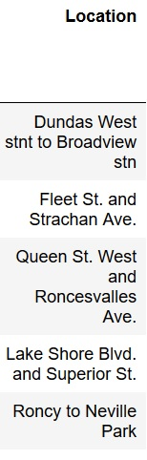
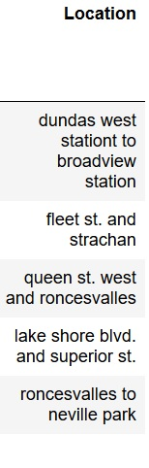
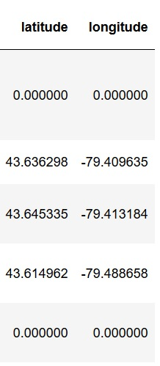
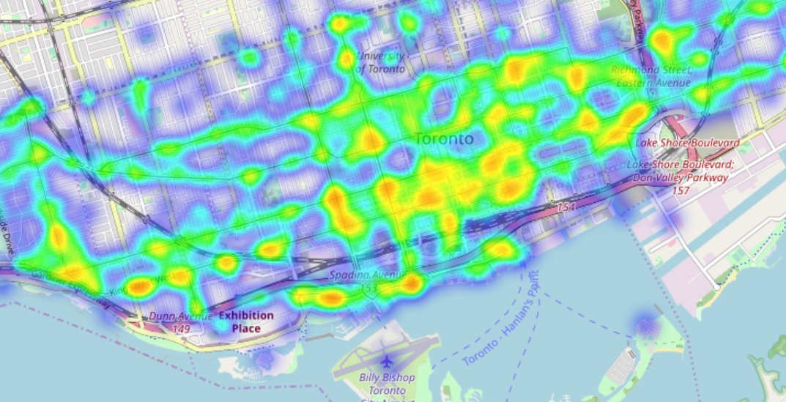
The dataset: locations
Clean custom code
Geocode Google Geocode API
Visualize
Folium

